Slide 1
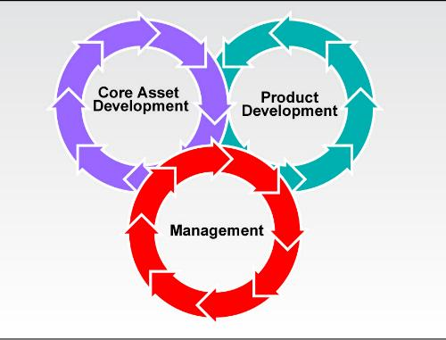
Introduction to Software Product Lines (SPL)

Slide 2
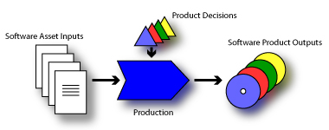
Software Product Line (SPL)
A set of software-intensive systems sharing a common, managed set of features that satisfy the specific needs of a particular market segment or mission and that are developed from a common set of core assets in a prescribed way.

Slide 3
Evolution of Software Development
Subroutines
70s
Modules
80s
Objects
90s
Components
Product Lines
Late 90s
2000

Slide 4
Overview of SPL
In the product line manager’s view, it should go like this:
Variability
1-Spl
Commonality
Develop product 2
2-Spl
Develop core
product
CORE
Develop product 3
3-Spl

Slide 5
Software Product Line Engineering
Software product lines refers to engineering techniques for creating a portfolio of similar software systems from a shared set of software assets
A product line represents a family of manufactured products
A product line architecture explicitly captures the commonality and variability of a product line components and their compositions
Software Product Line Engineering makes it possible to
- create software for different products
- use variability to customize the software to each different product

Slide 6

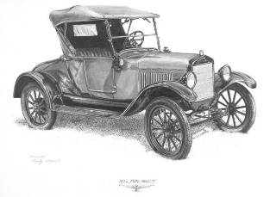
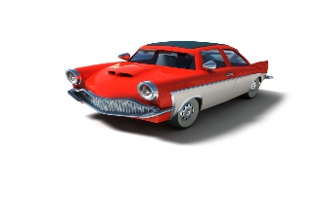



Product Lines - Motivation
Software is becoming complex
Reuse is becoming an imperative
Mass customization – producing goods and services to meet individual customer's needs – should be done with near mass production efficiency
Handcrafted for individual customers
Production Line – Mass Production
Mass Customization: large-scale production tailored to individual customers’ needs

Slide 7
Product Lines - Motivation
Any organisation that develops software creates multiple software applications that have some characteristics in common.
Whatever the commonalities are
amongst the software applications,
it is important that these commonalities be
managed properly so that the organization
can realize the highest economy of scale.

Slide 8
Product Lines – Goals and Characteristics
The three main goals of a software product line are to reduce cost, improve delivery time, and improve quality.
A software product line is a "family of products designed to take advantage of their common aspects and predicted variabilities“
The software product line practice was designed to manage software products, and their commonalities were designed to maximize the benefits to the organization.

Slide 9
Product Line Engineering Framework
Product Management
Domain Engineering
Product Management
Domain Engineering: Define and realize the commonality and variability. The goal is to establish a reusable platform
Domain Requirements Engineering
Domain Design
Domain Realisation
Domain Testing
Domain Artefacts incl. Variability Model
Requirements
Architecture
Components
Tests
Application Engineering
Application Engineering: Reuse domain artifacts, exploiting variability to build a product. The goal is to derive a product from the platform established in the Domain Engineering phase
Application Requirements Engineering
Application Design
Application Realisation
Application Testing
Application N – Artefacts incl. Variability Model
Application 1 – Artefacts incl. Variability Model
Requirements
Architecture
Components
Tests
Based on the “Software Product Line Engineering” book by Klaus Pohl,Günter Böckle and Frank J. van der Linden

Slide 10
Managing Product Line Systems
A product line is a decomposition of the entire application portfolio of an organization according to these common characteristics.
Figure 4-1. Product line development.

Slide 11
Core Asset Development
Core asset development is the creation and maintenance of the artifacts or core assets in the product line.
These core assets are used to create systems that match the quality criteria of the product line. For example, if the types of products that are developed in the product line have a high maintainability requirement, then the core assets should reflect this requirement and account for the need for good maintainability.
The goal of the core asset development activity is to create a capability within the organization to produce a particular type of application and will thus yield the same or similar software architecture.

Slide 12
Product Development
The second constituency is product development.
Product development involves the creation of products or systems from the core assets of the product line.
If a system requires an asset that is not included in the core assets, the core asset must be created if the asset can be shared across multiple products in the product line. It is a strategic decision whether or not to build a new core asset or to create a product-specific feature to the project under development.
If the core asset that exists in the product line does not match the quality requirements of the product under development, the core asset may be enhanced or modified.

Slide 13
Management
Management must be involved to ensure that the two constituencies are interacting correctly.
Instituting a product line practice at an organization requires a strong commitment from management. It is also important to identify which assets are part of the product line and which ones are part of the development of the individual products of the system.
Management consists of the management of individual projects within the product line, as well as overall product line managers. The role of product line manager is one of a product line champion.
The champion is a strong, visionary leader who can keep the organization working toward the creation of core assets while limiting any negative impact on project development.

Slide 14
SPL Production
Software Product Line Development Organization
Product 1
Production Strategy
Production Method
Production Plan
Product 2
Product 3
Core Assets
The core assets and product production system must be jointly engineered to achieve the organization’s goals for the software product line.
How can product development satisfy the organization’s goals for the software product line?
The goal is to reduce the risk to product line organizations by providing explicit techniques for strategizing and planning for product production.
The focus of our work is on product production as a system that is engineered to have specified production qualities and predictable outputs.
What processes, models, and technologies can be used to ensure consistency across the core assets?
What does the product developer need to know to effectively utilize the core assets to develop products?
Notes:
The SEI identified the importance of a product production focus early, for example, in the Software Product Lines book.

Slide 15
Product Line Benefits
From the SEI:
Benefits
Product lines can help organizations overcome the problems caused by resource shortages. Organizations of all types and sizes have discovered that a product line strategy, when skillfully implemented, can produce many benefits—and ultimately give the organizations a competitive edge.
Improved productivity by as much as 10x
Increased quality by as much as 10x
Decreased cost by as much as 60%
Decreased labor needs by as much as 87%
Decreased time to market (to field, to launch) by as much as 98%
Ability to move into new markets in months, not years

Slide 16
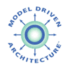
Introduction to Model-driven Product Line Engineering (PLE)
Product-Line Engineering (PLE)
Model-Driven Engineering (MDE)
Vision
Development activities oriented around product families
Manage commonalities and variabilities
Vision
Capture core software assets as platform-independent models (PIMs)
Automatically map PIMS to PSMs to code through model transformation
Obstacles
Larges upfront investment
Poor connection with regular “single-system” technology
1
3
2

